Slide 1

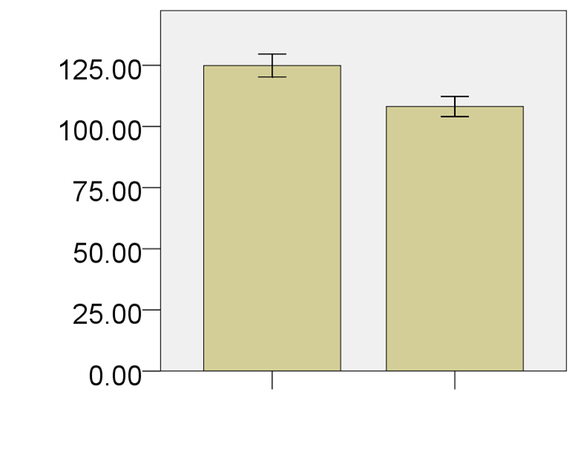
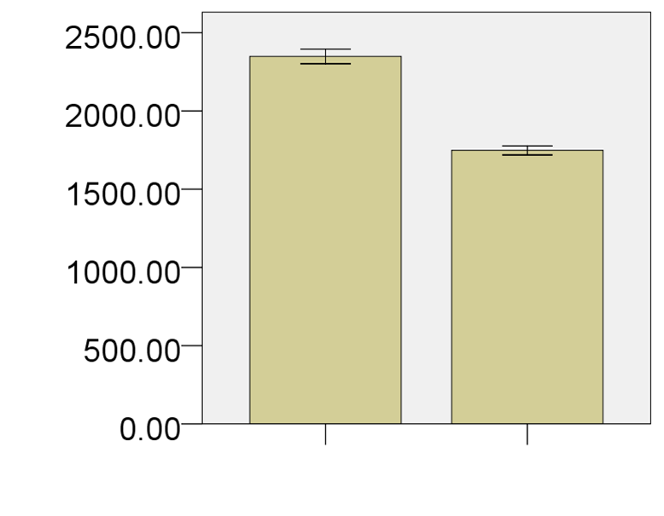
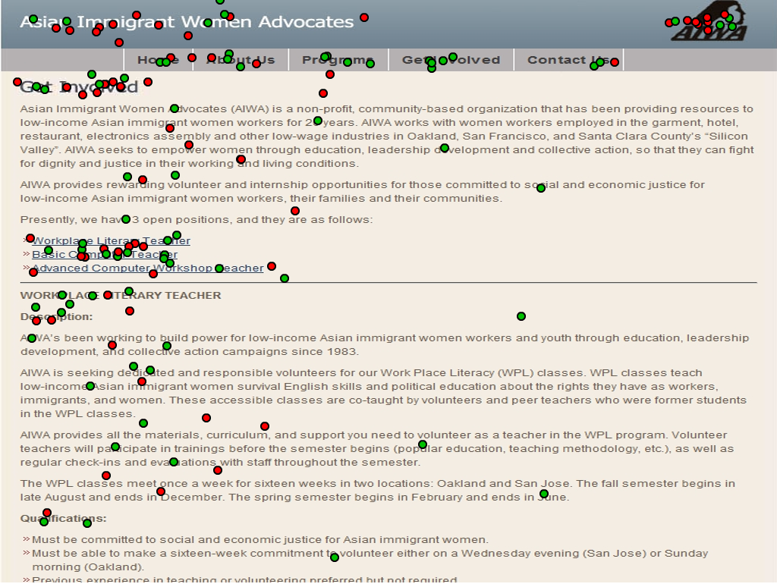
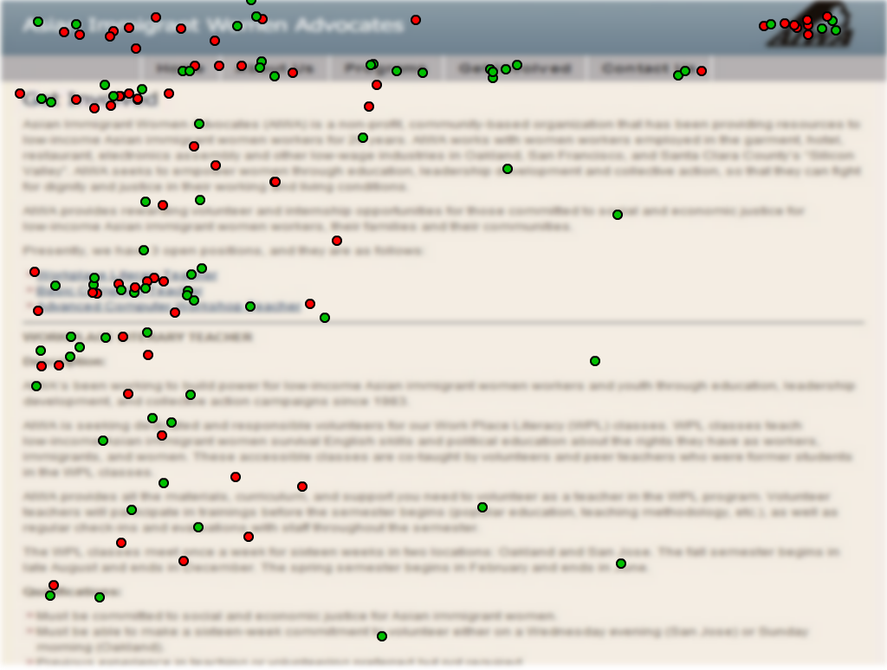
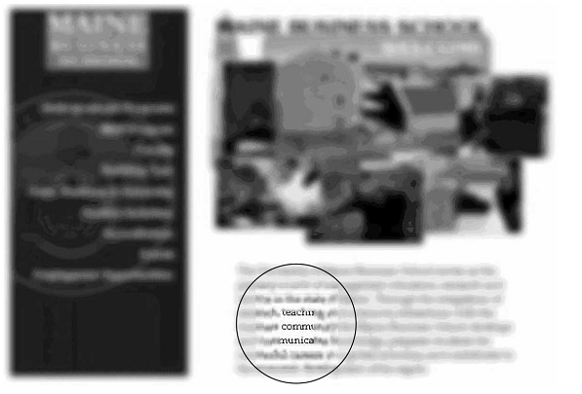
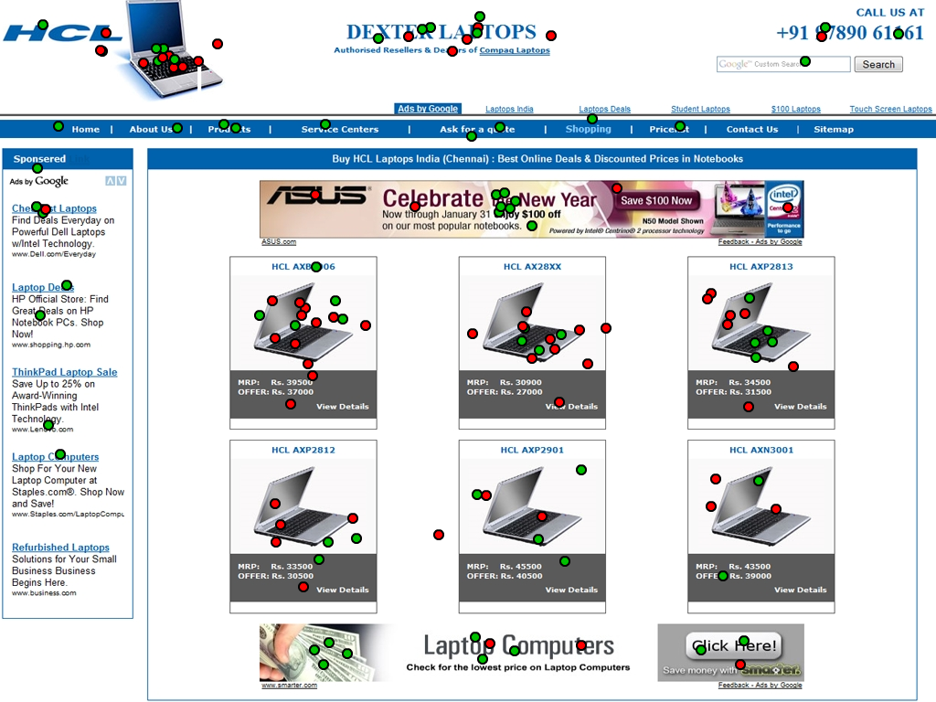
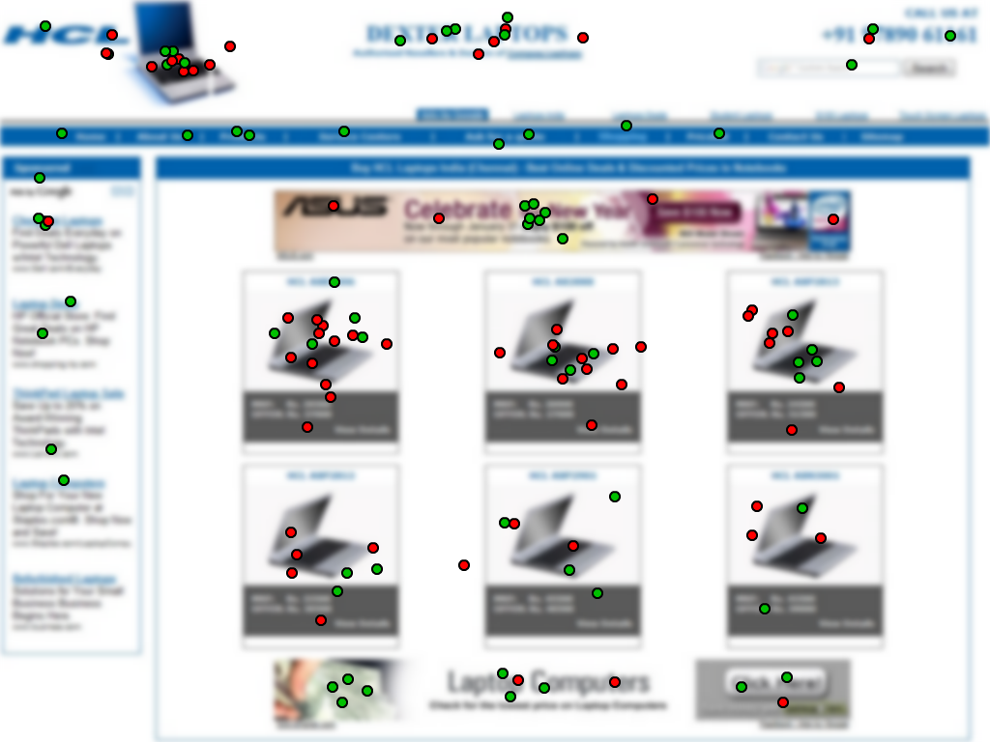
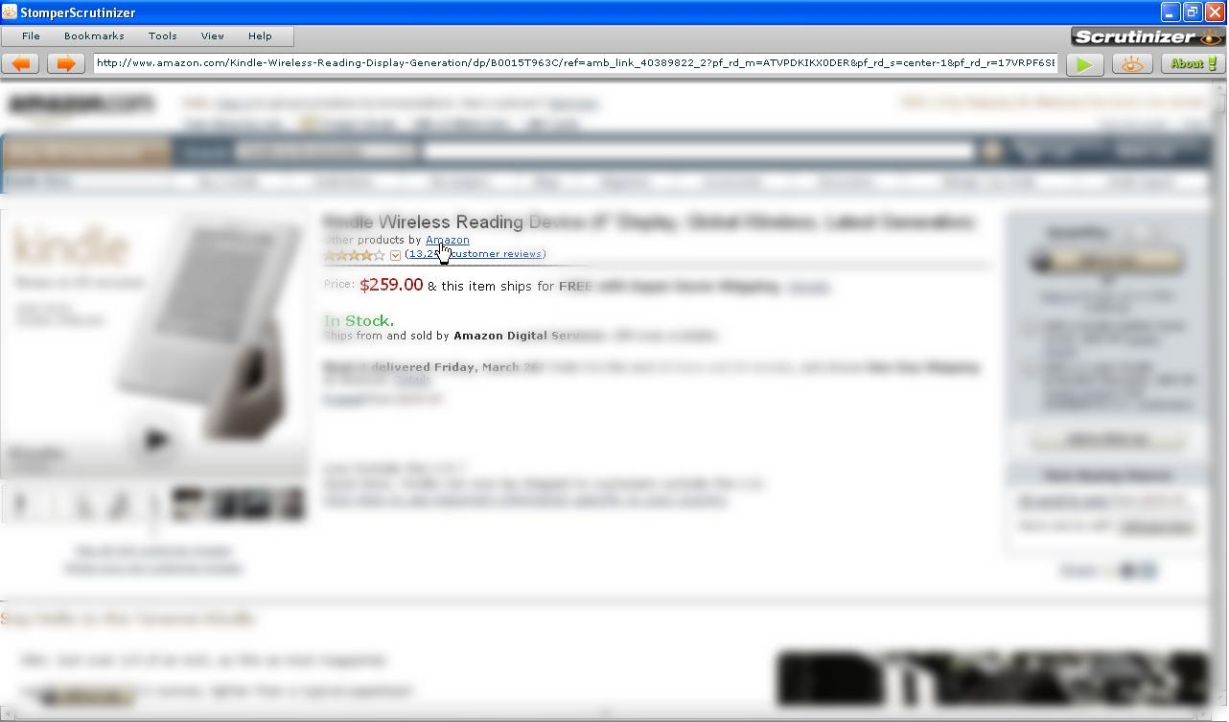
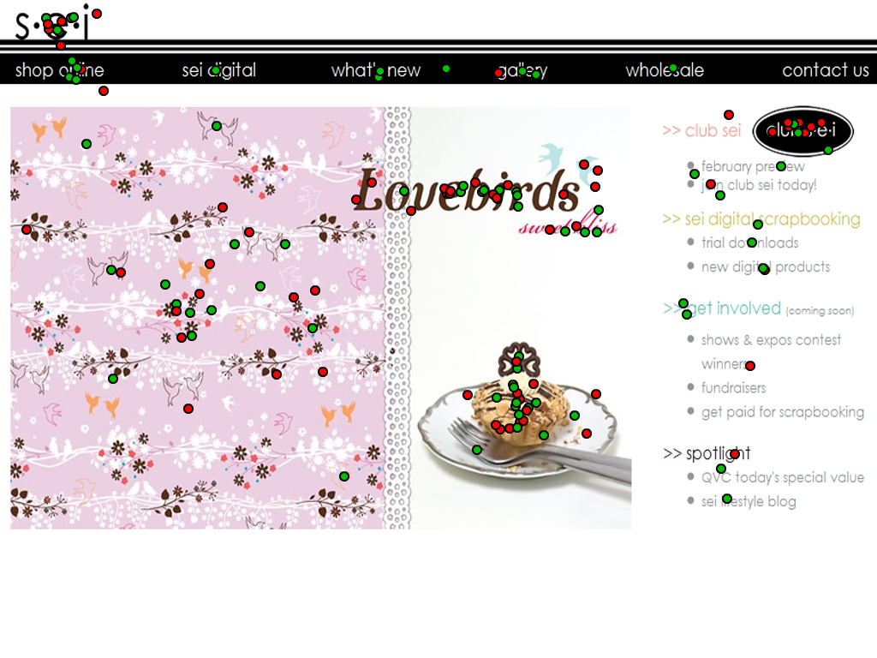


Effect of Opacity of Stimulus in Deployment of Interest in an Interface
Sujoy Kumar Chowdhury & Jeremiah D. Still
Missouri Western State University
Introduction
Websites are interfaces with rich visual information. Because of inherent limitation of our visual system, only certain regions in an interface get selected and attended for further cognitive processing. If a region fails to attract attention, it is quickly forgotten. Attention is guided both by bottom-up saliency (visual uniqueness) and top-down interest (semantics) within an interface. Masciocchi, Mihalas, Parkhurst and Niebur (2009) demonstrated that interest within natural and artificial scenes are associated with fixations. In this study we manipulate the availability of top-down information. This is achieved by showing either normal webpage screenshots or by blurring them until text semantics cannot be extracted.
The blurring technique can be related to the “squint test” that is prevalent in industry for evaluation of visual layout (c.f., Tarasewich et al, 2005; Stompernet Scrutinizer). Squinting of eyes makes text content unreadable while preserving overall structure in reduced detail (see Figure 1, 2). In a good design, the actionable or important elements are expected to be discernible even when blurred.
In this experiment, we are exploring whether the removal of high frequency visual information through blurring affects the deployment of attention by participants within a webpage. This study attempts to reveal whether locations of interest within webpage screenshots are being driven mostly by visual uniqueness or text semantics.
Method
Participants and Stimuli
We collected data from 26 participants (12 males). Each participant viewed a total of 50 images of websites. Half of the images (25) were clear and the rest were blurred. A custom designed desktop application was used for data collection. The sequence of images was randomly assigned.
Procedure
The participants were asked to, “click on the five most interesting points” in the screenshots. Small red circles were overlaid on the images to provide participants with visual feedback on click locations. At the end of the experiment, participants were asked how they defined interesting points for the experiment.
Results
Mean of distance (pixels)
Mean of selection time (ms)
Blur Clear
Error bars: +/- 1 SE
Blur Clear
Error bars: +/- 1 SE
The central tendency for interest points in blur condition is significantly less than that of clear condition. In a paired-samples t-test, the distances from grand average interest point for blur (M=124.93, SD=23.96) conditions were significantly higher than clear (M=108.16, SD=20.94) conditions, t(25)= 4.649, p < 0.001.
Point selection times for blur (M=2348.62, SD=2686.18) images were significantly longer than clear (M=1747.56, SD=1646.68) images, t(3249)=11.482, p < 0.001.
In the post-task questionnaire, most participants reported interesting locations as those containing pictures and colors.
Figure 3: Images with a significant difference in distances of
interest-points between clear (red) and blur (green) condition
Discussion
Interest points in blur images are distributed farther apart as compared with clear images. In addition, an increased cognitive processing time for blur images suggests that participants are not simply using a perceptual process to determine interest points. Rather, the delayed responses probably are resulting from a more reflective process. Thus, we do not believe that blurring interfaces is a useful technique for capturing the rapid deployment of attention.
Figure 1: Screenshot of Enhanced Restricted Focus Viewer
a: Text-dense websites
Figure 2: Screenshot of Stompernet Scrutinizer foveal gaze viewer
b: Product-array websites
References
Masciocchi, C. M., Mihalas, S., Parkhurst, D., & Niebur, E. (2009).
Everyone knows what is interesting: Salient locations which should
be fixated. Journal of Vision, 9(11), 1-22. doi: 10.1167/9.11.25
Tarasewich, P., Pomplun, M. , Fillion, S., & D. Broberg (2005). The
Enhanced Restricted Focus Viewer. International Journal of
Human-Computer Interaction, 19(1), 35-54
Stompernet Scrutinizer. Retrieved March 20, 2010 from website:
http://about.stompernet.com/scrutinizer
c: Image-dense websites
For more information, email schowdhury@missouriwestern.edu

