Slide 1
Eye Tracking: St. Joe Channel Website
Sujoy Kumar Chowdhury
Victoria Rodgers
Missouri Western State University

Slide 2
Comparing Ad Panels
The purpose of this study was to discover which ad panels people were most likely to look at within the webpage.
The panels were compared and ranked based on time spent on each ad to justify any differential pricing.

Slide 3
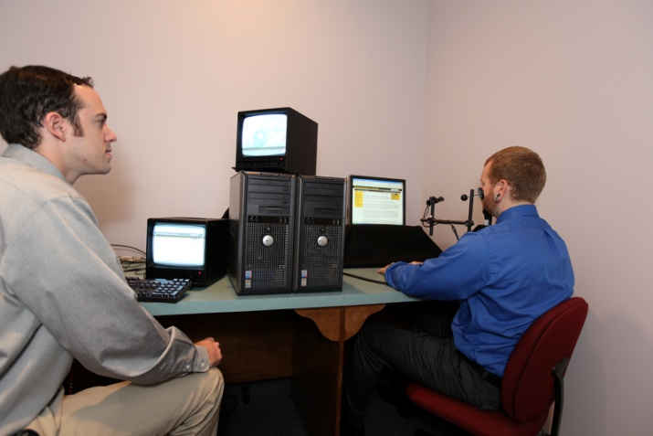
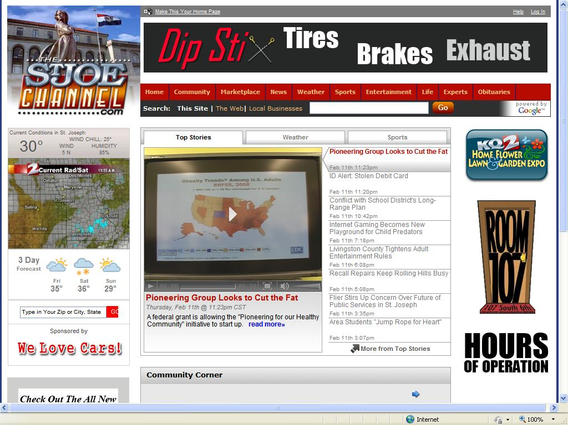
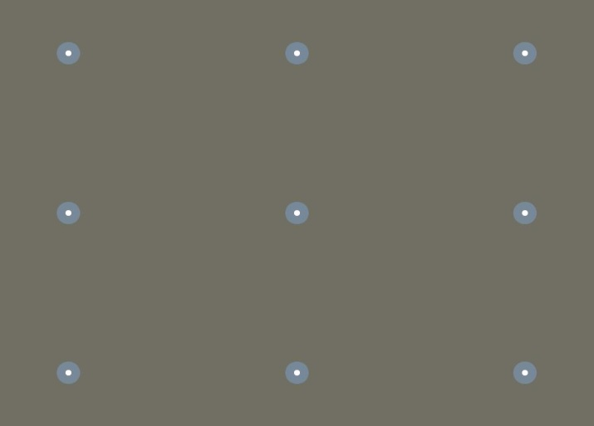
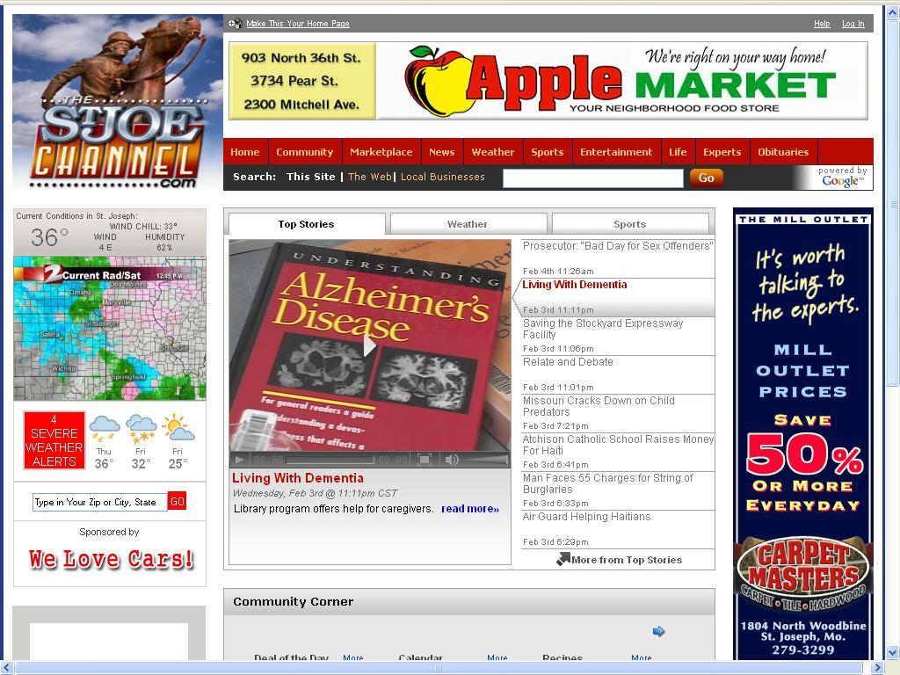
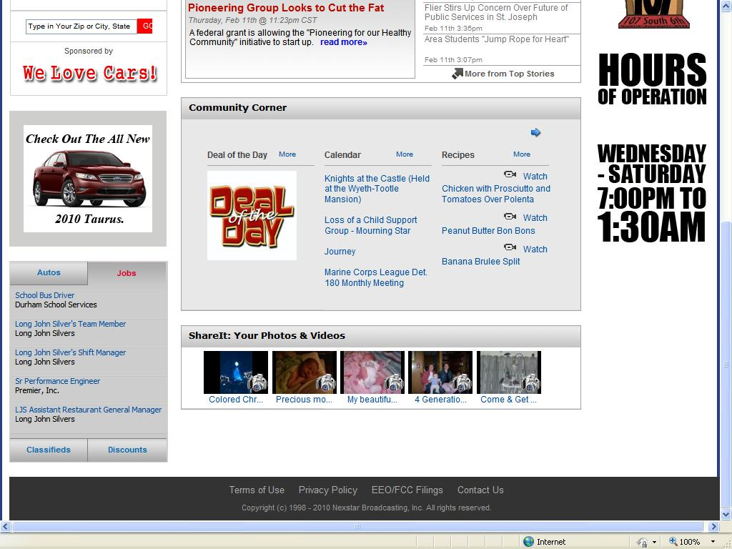
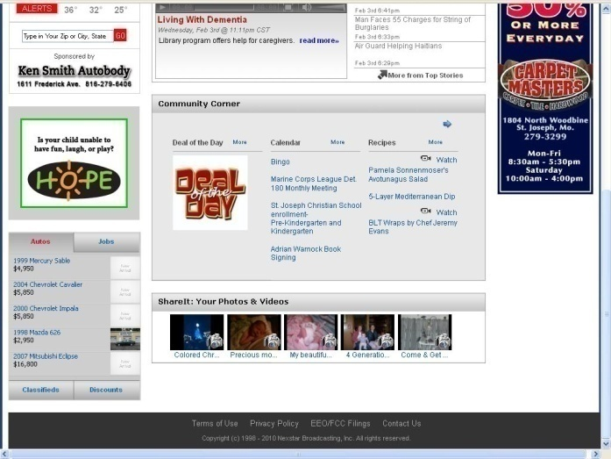
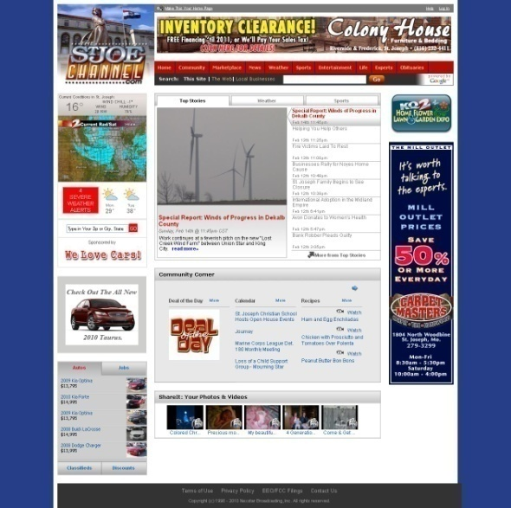
Method
Nine participants
Preparation
  IRB approval
  Recruitment
  Eye tracker set-up
  Lookzone creation
Steps
  Calibration of eyes
  Task: Look like free ‘surfing”
Notes:
Static screen shots, predict that motion will pull attention, but banner blindness will still occur regardless.

Slide 4
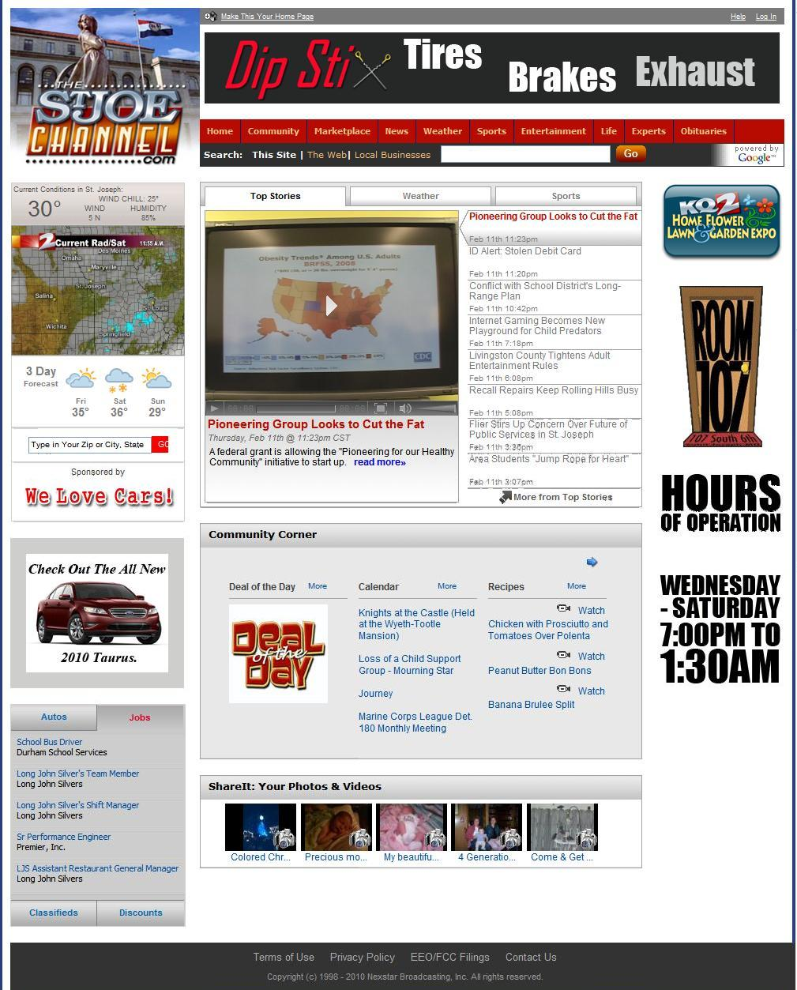
Naming scheme of Lookzones
C1A
L1C
C2C
Letter key:
Prefix:
L- Left
C- Center
R- Right
Suffix
A- Ad
C- Content
R11A
L2C
C3C
R1A
L3A
R12A
L4A
C4C
L5A
C5C

Slide 5
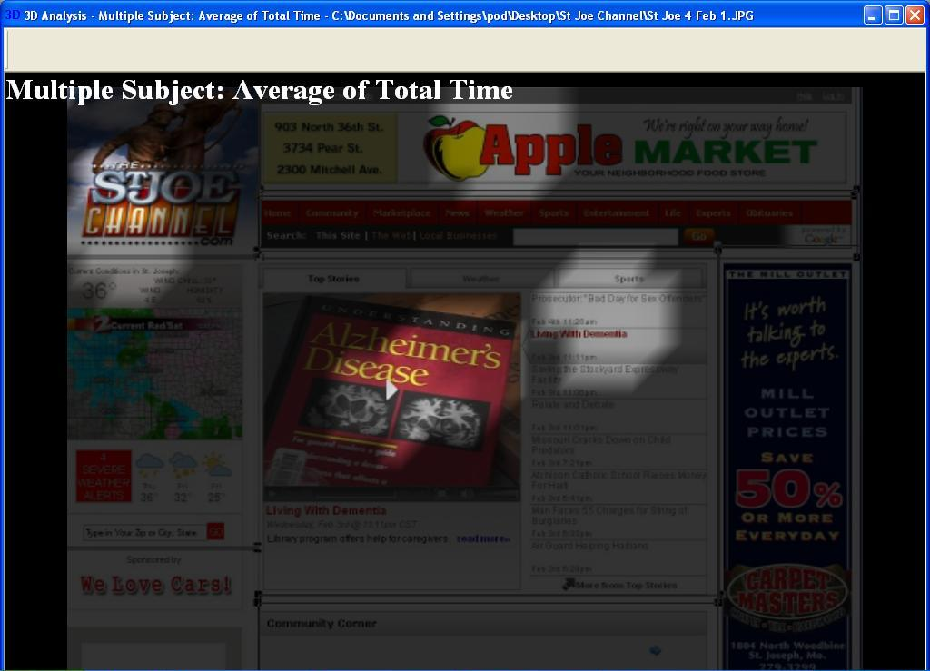
Slide 1 (Top View): Spot-light Graph

Slide 6
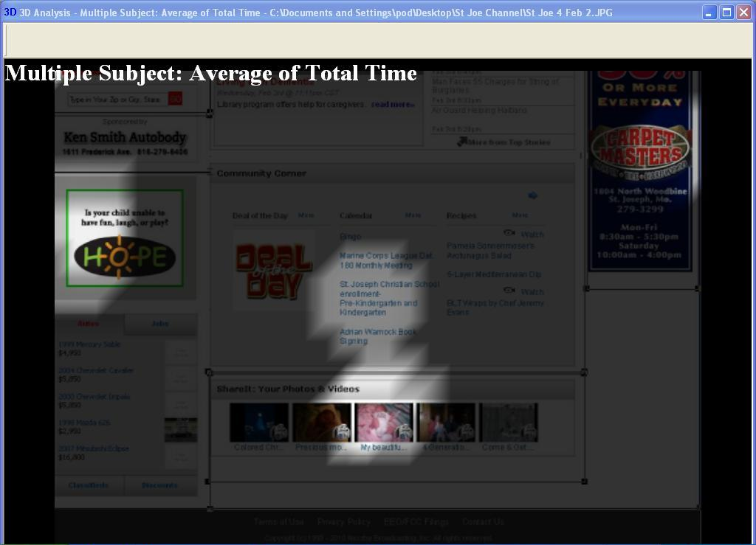
Slide 2 (Bottom View): Spot-light Graph

Slide 7
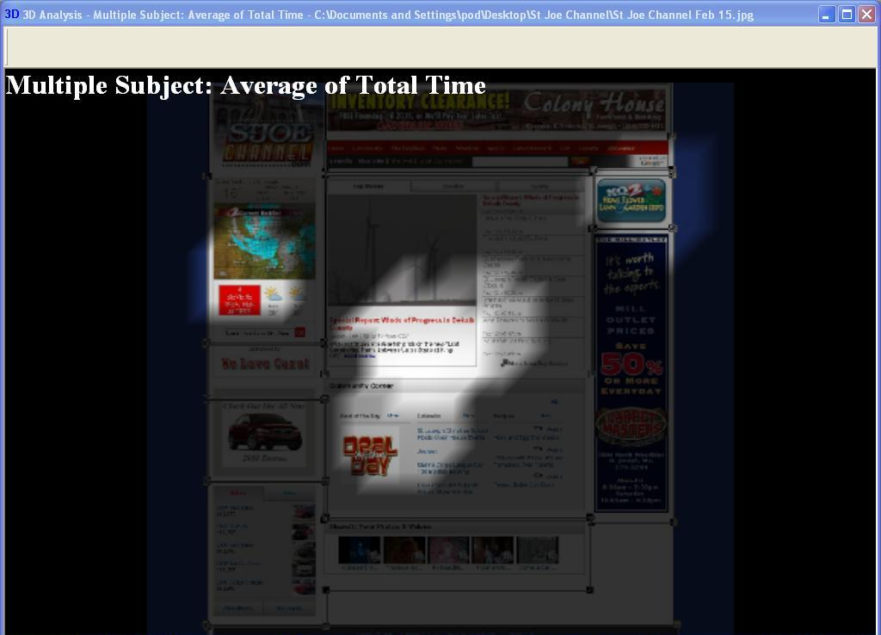
Slide 3 (Full View): Spot-light Graph

Slide 8
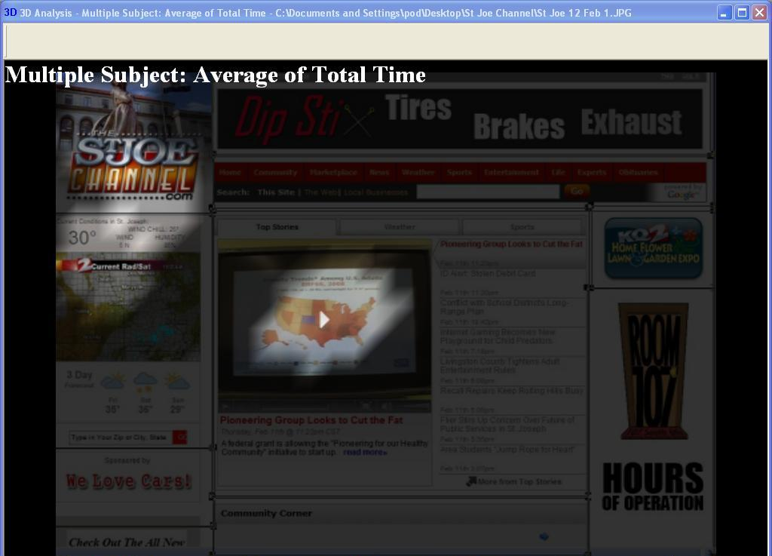
Slide 4 (Top view 2nd Time): Spot-light Graph

Slide 9
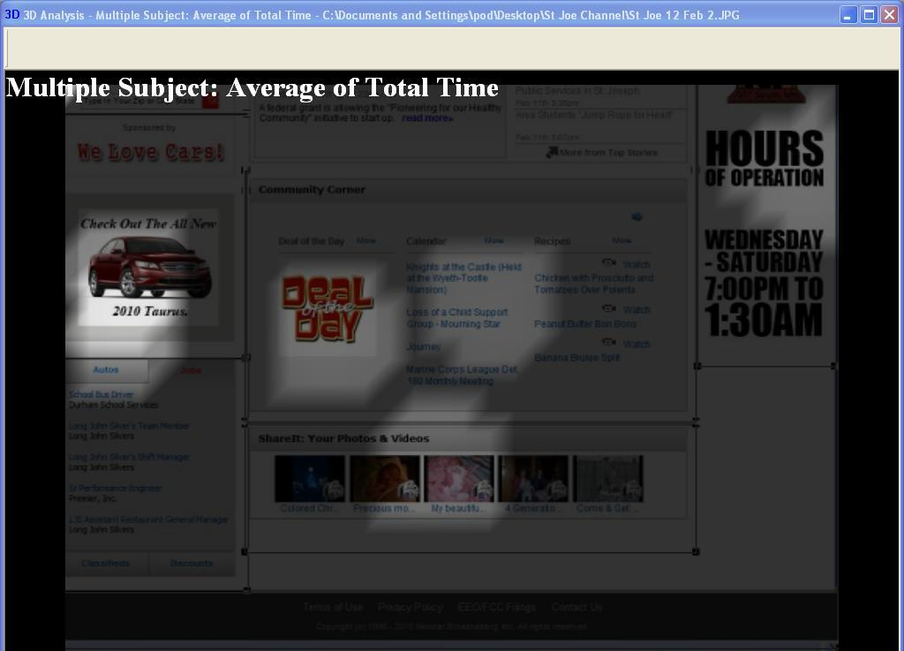
Slide 5 (Bottom View 2nd time): Spot-light Graph

Slide 10
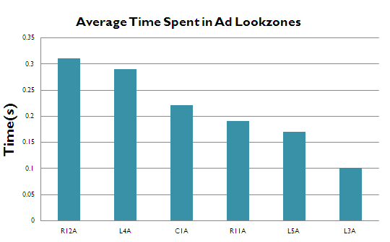
Average Time Spent in Adzones

Slide 11
Rank of Adzones (based on average time spent)
3
C1A
L1C
C2C
4
R11A
Rank | Zone
#1 | R12A
#2 | L4A
#3 | C1A
#4 | R11A
#5 | L5A
#6 | L3A
L2C
C3C
6
1
R1A
L3A
2
R12A
L4A
C4C
5
L5A
C5C
Notes:
To get this, we divided the number of fixations by the area of the lookzone, taken from the screen shot of the full webpage.
Notice two number fours, these lookzones tied for number of fixations over area. (less than .01 difference, take notice of graph later)

Slide 12
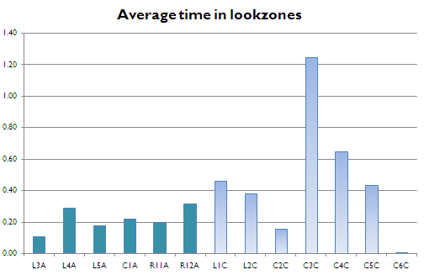
Average Time Spent in Lookzones
* R1A covers the same area jointly covered by R11A and R12A

Slide 13
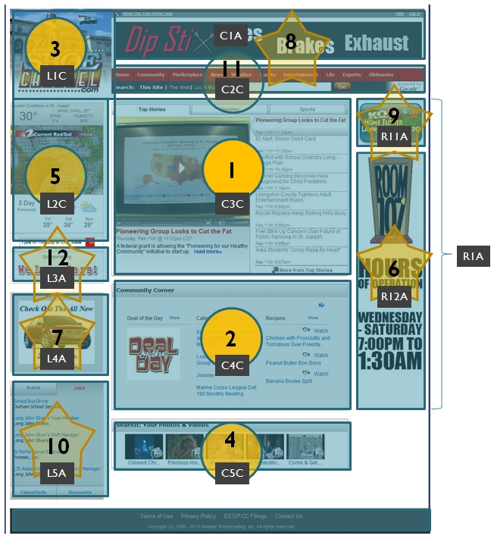
Combined ranking of look zones
(based on average time spent)
Rank | Zone
#01 | C3C
#02 | C4C
#03 | L1C
#04 | C5C
#05 | L2C
#06 | R12A
#07 | L4A
#08 | C1A
#09 | R11A
#10 | L5A
#11 | C2C
#12 | L3A

Slide 14
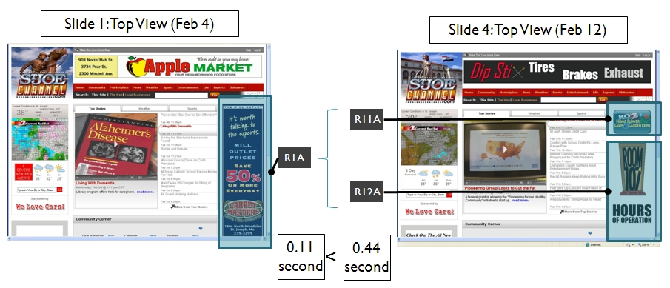
R1A, R11A and R12A Lookzones

Slide 15
Recommendations
Difference in time spent not significant enough to establish a new differential pricing model solely based on attention
Premium pricing is justified when look-zones are split (R1A)
Visual enhancement needed for L3A lookzone

Slide 16
L1C
C1A
C2C
L2C
C3C
R11A
R1A
$$$
R12A
L4A
$$
C1A
R11A
$
L5A
L3A
R12A
L3A
C4C
L4A
L5A
C5C
C6C

Slide 17
Rank of Adzones (based on average time spent)
L1C
3
C1A
C2C
4
L2C
C3C
R11A
R1A
Rank | Zone
#1 | R12A
#2 | L4A
#3 | C1A
#4 | R11A
#5 | L5A
#6 | L3A
R12A
6
1
L3A
C4C
L4A
2
L5A
5
C5C
C6C
Notes:
To get this, we divided the number of fixations by the area of the lookzone, taken from the screen shot of the full webpage.
Notice two number fours, these lookzones tied for number of fixations over area. (less than .01 difference, take notice of graph later)

